Slide 1
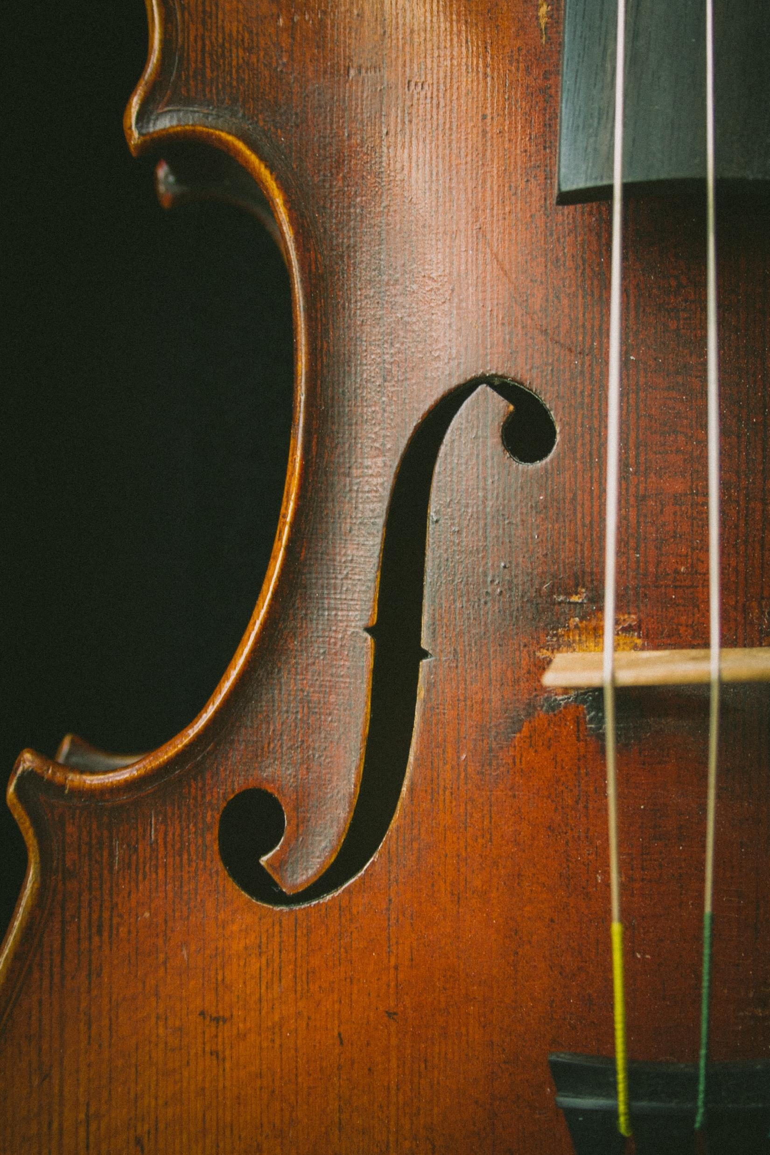
An Analysis of the Top Tracks on Spotify.
Presented By Alexandra Watson

Slide 2


Todays Goal…
To see what variables, affect a song's popularity for an independent music artist. They want to know what variables could positively impact the song's success. I will analyze the top 2,000 Spotify songs from 2000-2019.

Slide 3

Data collected and Cleaned.
Data was collected from Kaggle.com. “Kaggle is the world's largest data science community with powerful tools and resources to help you achieve your data science goals.”
Mark Koverha collected the data. “This dataset contains audio statistics of the top 2000 tracks on Spotify from 2000-2019.”
Data was imported to a Jupyter Notebook for me to clean and analyze.

Slide 4

Hypotheses 1
Null Hypothesis 1 (H0): There is no correlation between a songs duration and its popularity.
Alternate Hypothesis 1 (Ha): Does the duration of a song affect its popularity?

Slide 5
Hypotheses 2
Null Hypothesis 2 (H0): The BPM has no affect on a songs popularity
Alternate Hypothesis 2 (Ha): Are songs with a higher BPM more likely to be popular than those at a slower tempo?

Slide 6
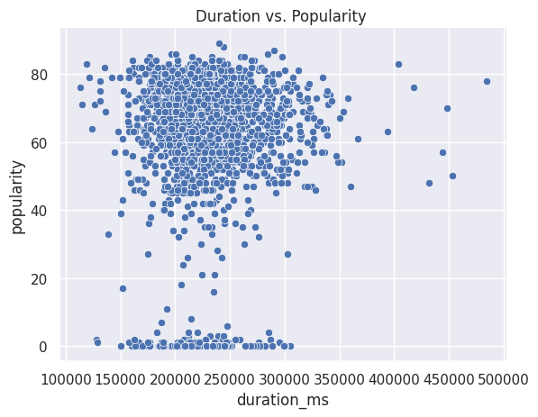
A songs duration Vs Popularity
0.05061721936219038
0.05061721936219038
What is the correlation between the duration and popularity of a song?
Pearson R Result statistic=0.0506, p-value=0.023
There is no correlation
Notes:
484,146.00 milliseconds is an 8-minute song!
MS = milliseconds
2,000 songs were used in this data set
I did a Pearson R test and found a correlation between duration and pop.
The p-value was 0.023 which means that the correlation was positive.

Slide 7
Results
There is no statistical significance that a songs popularity is affected by the songs duration.
Most popular songs are between 20,000 - 25,000 Milli seconds or 3.33 - 4.16 minutes long.
We can accept the null hypothesis.

Slide 8
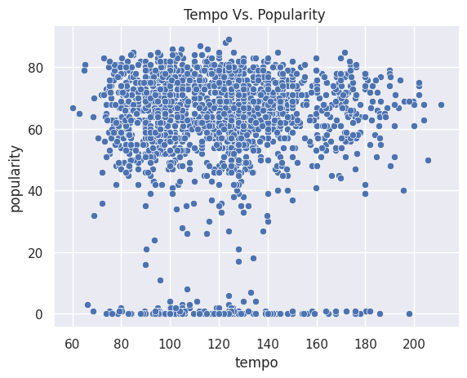
A Songs Tempo (BPM) Vs Popularity
What is the correlation between Tempo and Popularity?
There is no correlation between a song’s Tempo and a song’s popularity.
Pearson R test results statistic=0.0142, p-value=0.523
Notes:
2,000 songs were used in this data set
Max temp is 210 BPM that is called Prestissimo (anything above 200 bpm)
Prestissimo in English means very soon
Prestissimo is Italian
I did a Pearson R test and found no correlation between Tempo and pop.
The p-value was 0.023 which means that there was no correlation.

Slide 9
Results
The Null Hypotheses will be accepted.
There is no statistical evidence that a higher BPM will positively affect a song's popularity.
However there does appear to be a trend that highly popular songs are between 100-140 BPM.

Slide 10

RECOMMENDATIONS

Slide 11
In conclusion, we have found that a song has a better chance of being popular if it's not too long or short in duration.
It should be just right! Most popular songs are 3 to 4 minutes long. Based on my calculations we also discovered that a song's BPM doesn't affect its popularity.
we did discover a trend that most songs are between 100-120 BPM.
This information will help independent artists create music that will hold a listener’s attention.
Other factors need to be tested to determine what makes a song popular.
Notes:
In conclusion, we have found that a song has a better chance of being popular if it's not too long or short in duration. It should be just right! Most popular songs are 3 to 4 minutes long. Based on my calculations we also discovered that a song's BPM doesn't affect its popularity. But we did discover a trend that most songs are between 100-120 BPM. This information will help independent artists create music that will hold a listener’s attention. Other factors need to be tested to determine what makes a song popular.

Slide 12
Thank You.

